Slide 1

SRM INSTITUTE OF SCIENCE AND TECHNOLOGY SCHOOL OF COMPUTING DEPARTMENT OF COMPUTING TECHNOLOGIES
NFT Purchase Without Digital Wallet
Guided By:
Mr. Kumar Mehul (Organiser- Team Blockchain)
Presented By:
Team Animal: Aarush Kaushik Aryavart Chandel Yashwanth NV

Slide 2

Domain Overview
Blockchain is a distributed ledger technology that allows for secure, transparent, and tamper-proof transactions. It is a system of recording information in a way that makes it difficult or impossible to change, hack, or cheat the system.
Blockchain is made up of a series of blocks, each of which contains a number of transactions. The blocks are linked together using cryptography, which means that they are very difficult to change or hack.
Blockchain is a distributed ledger, which means that it is not stored in any one central location. Instead, it is stored on a network of computers, which makes it very difficult to tamper with

Slide 3
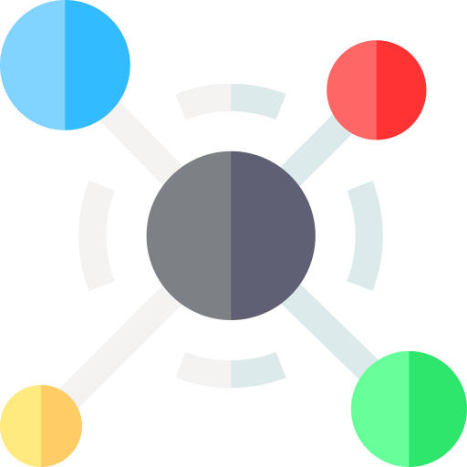
Abstract
Users browse the platform and choose the specific Non-Fungible token they want to purchase. Before entering the platform, a verification code is sent to the user's registered email address, and after authenticating, they can surf the platform for NFTs.
After selecting the NFT, the user clicks on the "Buy" button to proceed with the purchase. The user is prompted to enter their credit card details, including card number, expiration date, CVV code, and billing address.
The user retrieves the code and enters it on the platform to verify their identity. Finally, the user confirms the purchase. The platform securely processes the payment using the provided credit card information.

Slide 4

Objective
Non-fungible tokens (NFTs) are digital assets that are stored on a blockchain and can represent ownership of anything from digital artwork to video game items. While NFTs can be purchased and sold using cryptocurrencies, this can be a daunting task for those who are new to the world of blockchain technology.
This project proposes a new method for purchasing NFT’s using a credit card yet is a Decentralized application there by increasing the community of NFT’s.
This method would make it easier for people to get involved in the NFT market without having to learn about cryptocurrencies or set up a crypto wallet.

Slide 5

Problem Definition
Existing NFT trading platforms currently restrict payment options to cryptocurrencies, creating a barrier for users without crypto holdings. However, our innovative solution addresses this limitation by introducing credit card payment integration.
This breakthrough development eliminates the need for users to possess cryptocurrencies and opens up NFT ownership to a wider audience. By offering a seamless credit card payment gateway.
We revolutionize the NFT market, making it more accessible and convenient for both creators and collectors.Experience hassle-free NFT purchases with our platform's inclusive payment solution.

Slide 6
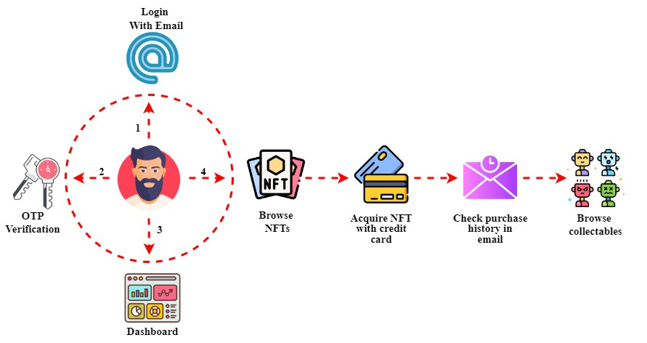
Architecture

Slide 7



Technical Stack & Usage
React JS is a popular framework for developing single-page applications (SPAs). It also has a wide
Thirdweb is a complete web3 development framework that supports many languages, including React, React Native, TypeScript, and Go. It can be used
WithPaper is a developer platform that lets you add Embedded Wallets, Checkouts, and Airdrops to
range of libraries that support the creation of blockchain apps
your NFT platform or project.
to integrate wallet connections, mint NFTs, and create marketplaces.

Slide 8
Reference
“Market Volatility and Speculation in the NFT Market: A Preliminary Analysis" by A. Smith, B. Jones, and C. Brown, IEEE Transactions on Emerging Topics in Computing, vol. 3, no. 3, pp. 1-7, July 2023.
"Blockchain and NFTs for Time-Bound Access and Monetization of Private Data" (2023) by Elsi Ahmadieh and Nour El Madhoun. This paper proposes a system for using blockchain and NFTs to allow users to sell access to private data for a limited period of time. The system uses two smart contracts: one to manage the NFTs and one to control access to the private data
"Performance and Cost Evaluation of Public Blockchain”: An NFT Marketplace Case Study" by A. Smith, B. Jones, and C. Brown, IEEE Conference Publication, vol. 9908999, pp. 1-6, March 2023.

Slide 9
THANK YOU!

